Slide 1

Conséquences, règles et principes
025947 - Documentation logicielle, bonnes pratiques en programmation
Marco Lavoie
025914 - Assurance de qualité logicielle

Slide 2
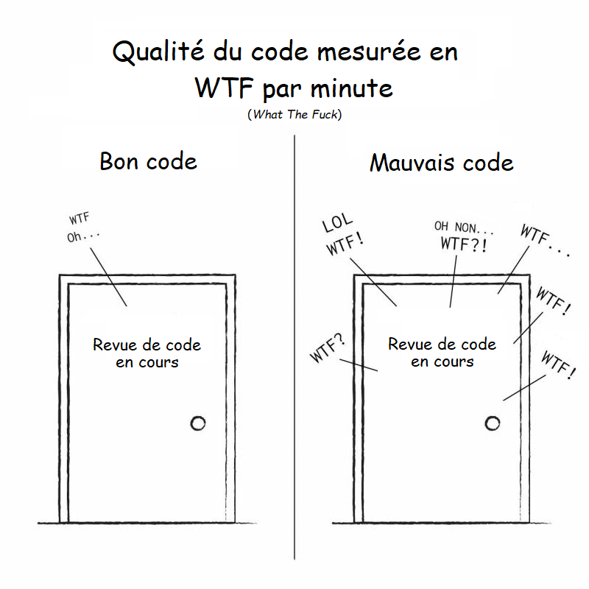
Qu’est qu’un bon code?
C’est un code que tout le monde comprend

Slide 3
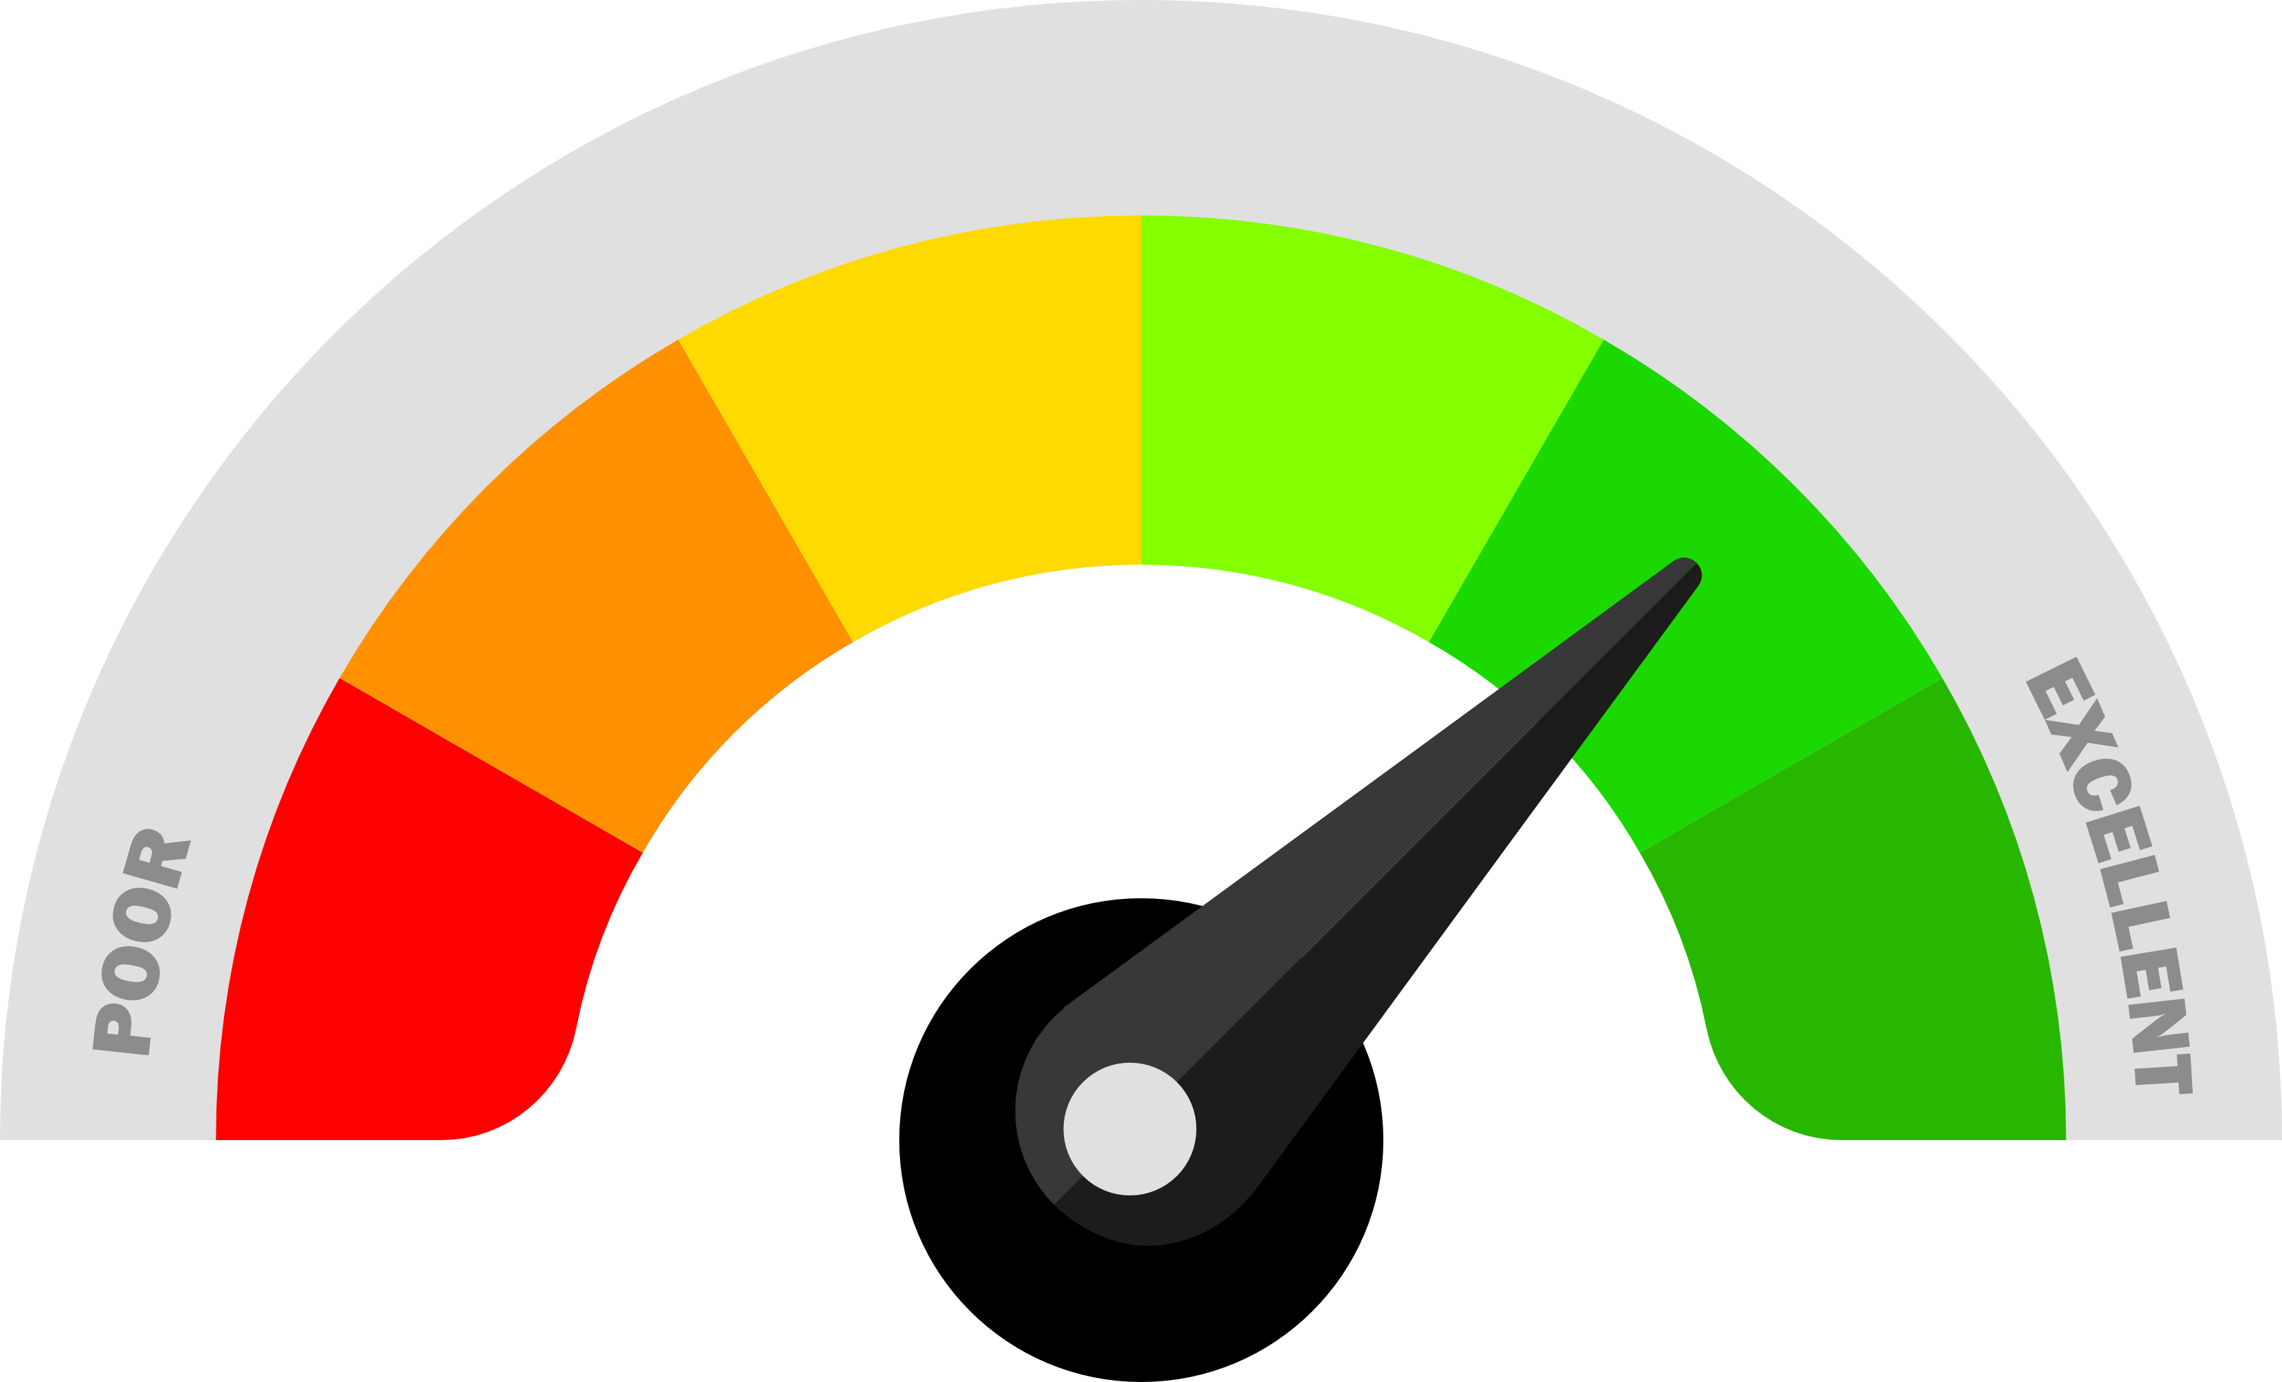
Caractéristiques d’un bon code?
Testable (et testé)
Élégant
Simple
Compréhensible
Efficace
Lisible
Maintenable
Documenté
Dépendances minimales

Slide 4
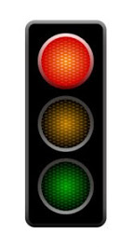
Qu’est-ce que du mauvais code
Illisible
Indentation inconsistante
Mauvais noms d’identificateurs
Manque de commentaires
Manque d’attention aux détails
Fonctions / classes trop complexes
Non testable
Structure du code non adaptée aux tests
Aucune ressource/temps alloués aux tests
Notes:
Before we explore the consequences, let us examine the properties of ‘bad’ code, from a level that is understood by business and project/program managers. ‘Bad’ code primarily has the following attributes:
It is not readable – if a new person joins the team, it takes them an abnormally long time to be productive – fix bugs, add features, and so on. This aspect of ‘bad’ code can be due to several reasons, here are some of them:
Badly organized code and poorly structured or very large control flows – the largest control flow sequence I have seen, had a straight block of three-level nested if-then-else blocks that ran into approximately 5000 lines, wrapped in a try-catch block
Carelessly named classes that do not give a clue to the reader about the intent of the programmer
Architectural and design issues such as modules with too many in-coming and/or outgoing dependencies, tightly coupled components, and so on
Poor attention to detail on issues of scalability, security, etc. – again an architectural issue
It is not testable – I have always maintained that testability is one of the hardest properties to understand and address as an architect. Of course, by looking at the code, one can detect poor testability, due to the reason explained in point 1(1) above. But since many of the project management and executive management members do not have the time to engage at this level of detail, they often miss this important non-functional ability of a system. However, this can be easily observed from the simple activity of measuring the time spent on testing/debugging vs the time spent on development, as the project progresses. This might seem like a blindingly obvious metric to track, but many teams do not have this information readily available.
It is hard to extend – because of the combined effects of lack of readability and testability, defined above. How does one detect it, other than by looking at the code? If, as the project progresses, you find that even trivial features are taking a long time to deliver, then you have a problem of extensibility.

Slide 5
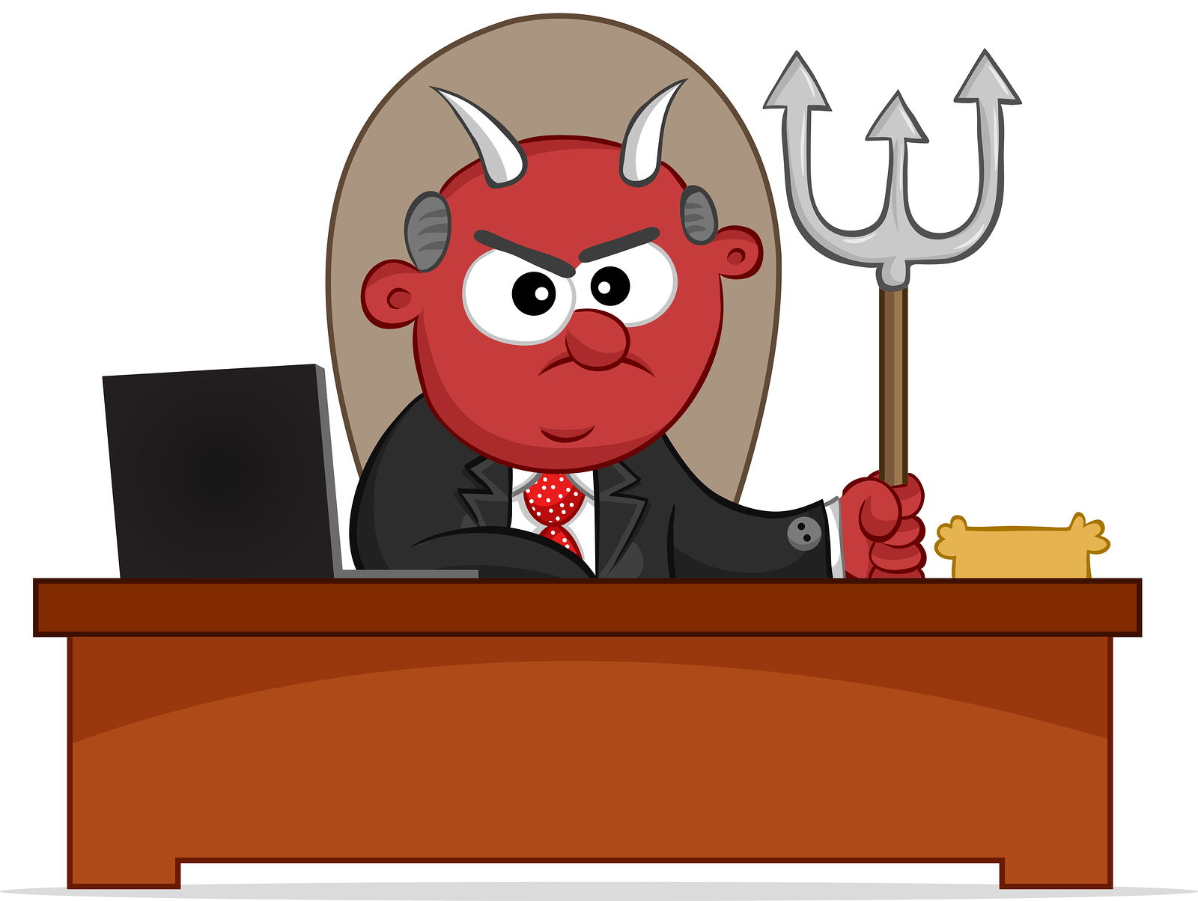
Pourquoi produire du mauvais code
Problèmes de gestion
Pression constante des gestionnaires pour produire du code rapidement
Emphase sur les objectifs à court termes
On s’occupera de la maintenance plus tard
Mais « plus tard » ne viendra jamais!

Slide 6
Conséquences d’un mauvais code
Détérioration graduelle de la qualité
On ne fait que « patcher » le code
Introduction de bogues
L’ajout de fonctionnalités devient
Graduellement impossible
De plus en plus coûteux
L’équipe de développement devient de dysfonctionnelle
Conflits, découragements, transferts vers d’autres projets
Les clients sont mécontents
Frustrés des bogues récurrents
Délaissent le produit
Notes:
The consequences of these can prove to be extremely frustrating and expensive:
The general perception of the quality of the output begins to deteriorate as the team spends more and more time in fixing bugs than in actually creating new features
In extreme cases, adding features becomes virtually impossible with seemingly unrelated parts of the system failing due to the addition of a feature or, worse – fixing an earlier bug
Costs of adding features increases at an alarming rate with each delivery cycle
Adding more people becomes difficult, as they take a long time to come up to speed; sometimes, new team members are blatantly scared to touch large parts of the code, due to the fear of failure
Customer complaints increase, putting intense pressure to write an even worse code – to keep fixing the issues quickly

Slide 7
Mesures d’atténuation
Formation des programmeurs
L’entreprise doit mettre en place des « politiques » de programmation
La correction de code non conformes à ces politiques doit être prioritaire
Si possible, imposer des outils automatisés de mesure de qualité de code
Les programmeurs n’auront pas le choix d’adhérer à ces politiques
Mettre en valeur l’importance de bien coder
Pas seulement chez les programmeurs, mais dans l’ensemble de l’entreprise
Et surtout, faire des tests
La mise à l’essai est dans un autre cours de votre programme
Notes:
So, what do we need to do?
Well, we need to get back to basics. Managers and businesses must not accept code that has the above-mentioned characteristics – i.e. ‘bad’ code. If they find such a code, they must prioritize and fix the problems with the same intensity and seriousness that they apply to feature development. Software development teams must be open to adopting automated and instrumented systems for measuring the quality of code, and managers must keep a close watch on the primary output of the team – the code.
But eventually, it is the practitioners-programmers, designers, architects, and testers – who need to take responsibility. This can only be done by acquiring a high level of self-discipline and professionalism in the way the code is designed, written, and tested. We must take pride in our craft and ensure that we do not write ‘bad’ code.

Slide 8
Principes à mettre en pratique
Simplicité
Éviter de compliquer les choses!
Éviter les répétitions
Plutôt que dupliquer un code, l’encapsuler dans une fonction
Éviter le code mort
Si un code source n’est pas utiliser, le supprimer
Favoriser la lisibilité
Rien ne sert de nommer les identificateurs de façon succincte
Favoriser la cohérence
Appliquer les mêmes pratiques dans l’ensemble du projet

Slide 9

Mise en application des principes
C’est comme faire de la bicyclette
On a beau connaître les principes de gravité, d’équilibre et d’entropie, on apprend à faire du vélo par la pratique
C’est la même chose en programmation : les principes s’apprennent en les mettant en pratique quotidiennement
Ce ne sera pas un cours théorique
Beaucoup de mises en situation!

